Slide 1
Jermyn Borough Council Meeting
2/19/2026

Slide 2
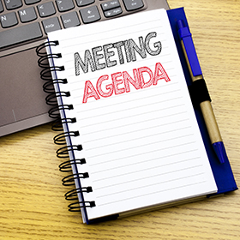
Meeting Agenda
FEB 19, 2026
CALL TO ORDER
PLEDGE OF ALLEGIANCE
ROLL CALL
PREVIOUS MEETING MINUTES
TREASURE REPORT/BILLS PAYABLE
CORRESPONDENCE
SECRETARY REPORT
PUBLIC COMMENT
PROFESSIONAL REPORTS
COMMITTEE REPORTS
PATHSTONE PARTNERSHIP
PENNDOT MULTIMODAL TRANSPORTATION FUND APPLICATION
INTERMUNICIPAL SEWER SERVICE AGREEMENT
NORLACK
PSAB ANNUAL CONFERENCE
ONGOING LEARNING AND COMMITMENT TO GET MORE EDUCATED
MARCH 4 DATA CENTER WORKSHOP
WEBSITE/TECHNOLOGY UPDATES
PUBLIC AWARENESS
WORK SESSIONS
CODE OFFICER
NEW BUSINESS
ADJOURNMENT

Slide 3
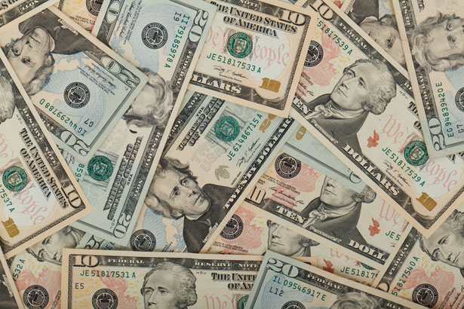
Treasurer’s report
2/19/2026
ASSETS
Checking/Savings
American Rescue Plan Fund 92,608.08
Capital Reserve - DPW 1,275.21
Capital Reserve - Police 7,129.82
Crime Watch Fund 222.69
General Fund - Community 64,503.42
General Fund - FNB 1,427.14
Holiday Lights Fund 400.59

Slide 4
Treasurer’s report
Investment - General Fund 1,177.32
Investment - Liquid Fuels 25,923.30
Investment - Paving Fund 1,189.57
Investment - Recycling 129.64
Investment - Refuse 185.42
Liquid Fuels - FNB 582.19
Petty Cash 194.00
Recreations Fund 23,533.80
Recycling - Community 10,141.26
Refuse Checking - FNB 85,910.52
Total Checking/Savings 316,533.97

Slide 5
Treasurer’s report
200000 · Accounts Payable 12,491.13
Long Term Debt 0

Slide 6


